Slide 1
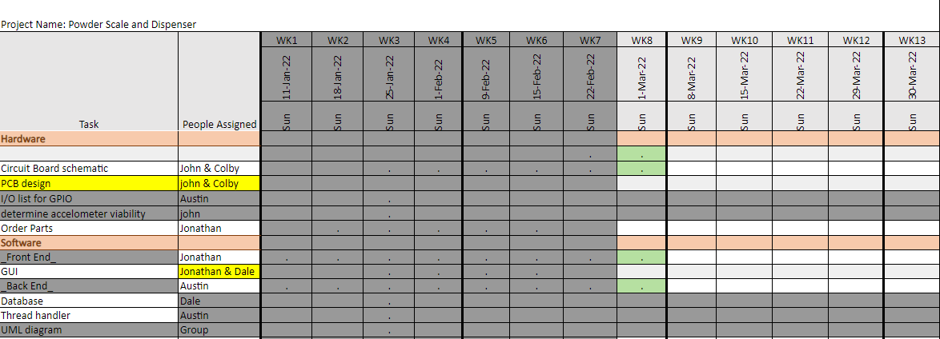
Week 7 (16-Feb to 22-Feb)

Slide 2
Week 7 (16-Feb to 22-Feb) Austin Stecklein
Goal/Task | % Done | Hours (Act.)
Documentation format |  | 4
Backend testing |  | 8
Hours on task during the week (On track ≥ 10 / wk) | 12
Total hours on task so far this semester (On track ≥ 85 hrs) | 80

Slide 3
Progress made during the week (Log) (What I did)
Starting creating software and hardware documentation format. Theory, application, examples, and building on
Testing stepper dispensing
Testing PID
Testing reading from the scale

Slide 4
Goals for this coming week (Ones that move the project forward the most)
Goal/Task | Stop Date (Est.) | Hours (Est.)
Continue testing with GUI and understating limitations of screen |  | 8
Continue working on documentation |  | 4
Estimated time needed to work on goals for this coming week (typ. 13 hrs) | 12

Slide 5
Week 7 (16-Feb to 22-Feb) Colby Hatton
Goal/Task | % Done | Hours (Act.)
Schematic | 92% | 2
Layout | 18% | 9
Research/Troubleshooting | N/A | 5
Hours on task during the week (On track ≥ 10 / wk) | 16
Total hours on task so far this semester (On track ≥ 85 hrs) | ~85

Slide 6
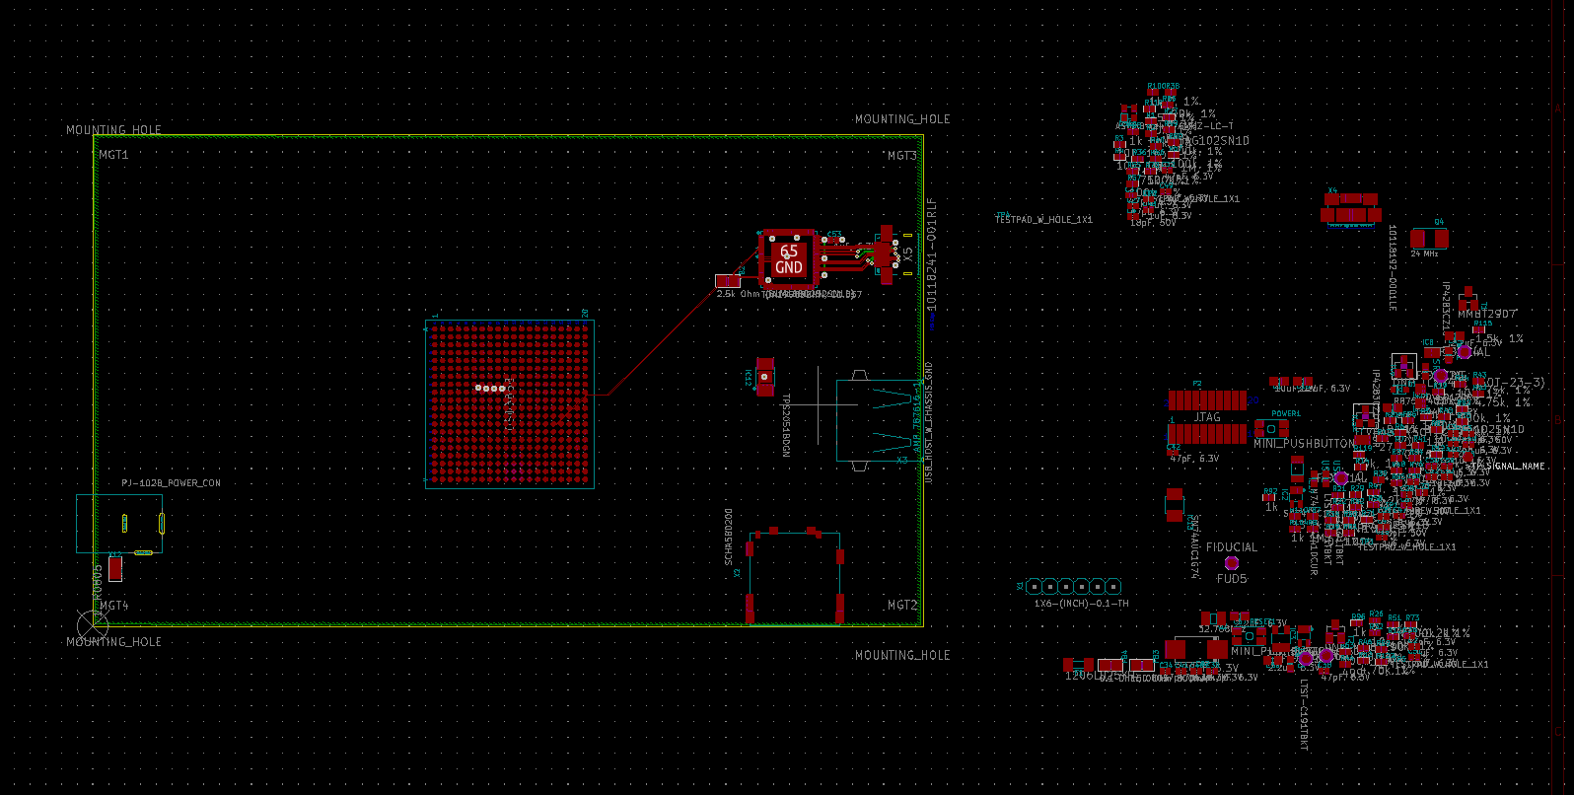
Progress made during the week (Log) (What I did)
Further work on PCB Layout. Learned multiple aspects of the layout process on KiCad.

Slide 7
Difficulties encountered during the week (What I did not do and why)
As with most PCB Software, there's a lot of unexplained behavior.
Attempted to route the power wire unsuccessfully.

Slide 8
Goals for this coming week (Ones that move the project forward the most)
Goal/Task | Stop Date (Est.) | Hours (Est.)
Layout | 2/28 | >13
Estimated time needed to work on goals for this coming week (typ. 13 hrs)

Slide 9
How can we help you achieve your goals?
Finalize parts
Pray for me

Slide 10
Week 7 (16-Feb to 22-Feb) John Stinger
Goal/Task | % Done | Hours (Act.)
Driver Research and Selection |  | 5
Finding a Power Adapter |  | 2
Help with Board Devel |  | 3
Hours on task during the week (On track ≥ 10 / wk) | 10
Total hours on task so far this semester (On track ≥ 85 hrs) | 72

Slide 11
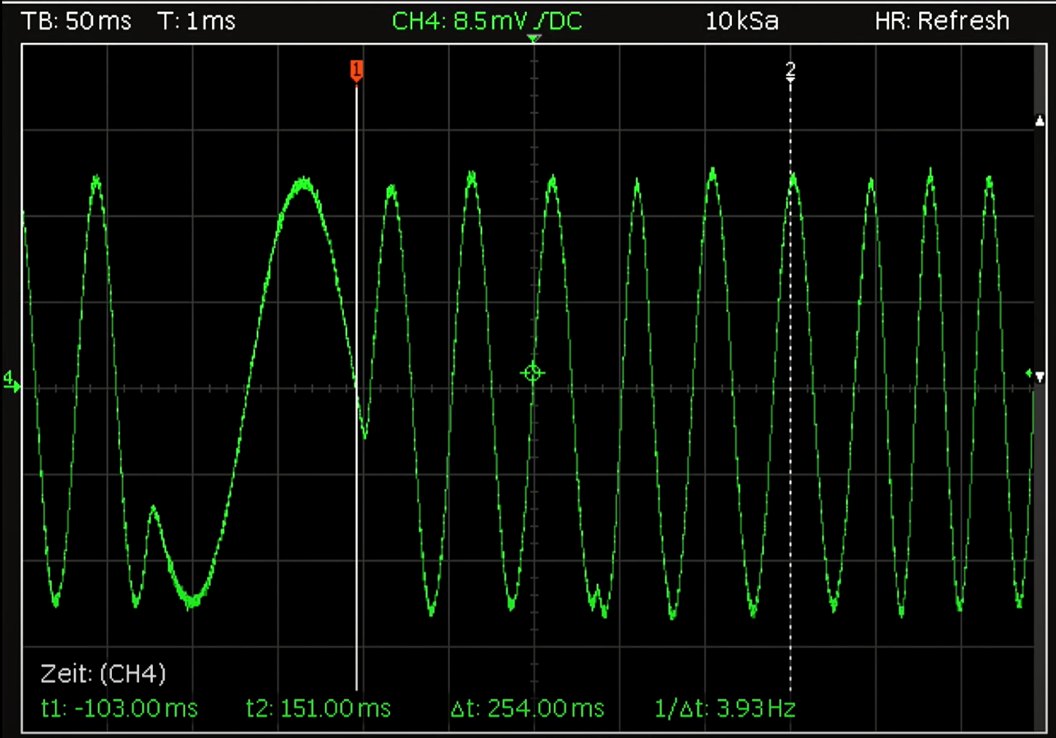

Progress made during the week (Log) (What I did)
For example: Resources found (links, manuals), Designs created, Decisions made and corresponding rational, Photos of prototype progress, etc.
Chose the Trinamic TM2208
4.75V – 36V

Slide 12
Difficulties encountered during the week (What I did not do and why)
None

Slide 13
Goals for this coming week (Ones that move the project forward the most)
Goal/Task | Stop Date (Est.) | Hours (Est.)
Continue Board Development |  | 10+
Resolve operating voltage |  | 3
Estimated time needed to work on goals for this coming week (typ. 13 hrs) | 13+

Slide 14
How can we help you achieve your goals?
Continue to be available for reference.

Slide 15
Week 7 (16-Feb to 22-Feb) - Dale Andreoli
Goal/Task | % Done | Hours (Act.)
Implement Load screen on the new design | 90 | 2
Implement Save screen | 60 | 6
Implement Settings screen | 60 | 5
Project Objective / Mission Statements
Power Scale Dispenser:
Design, build, and test the electronics for the dispenser with a touch screen display and controlling two stepper motors by April 6, 2021 with a prototyping budget of $1000 USD and for less than 600 people-hours.
Hours on task during the week | 13
Total hours on task so far this semester | 83

Slide 16
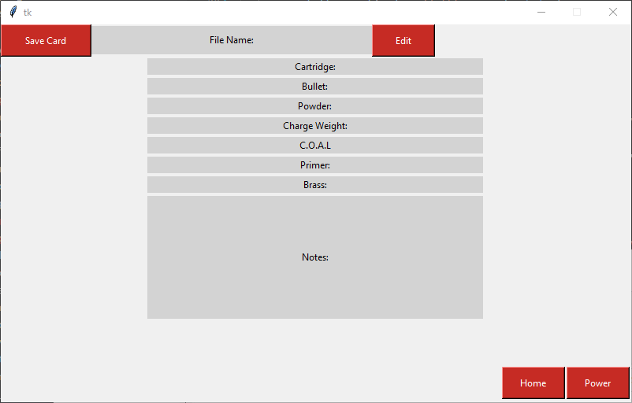
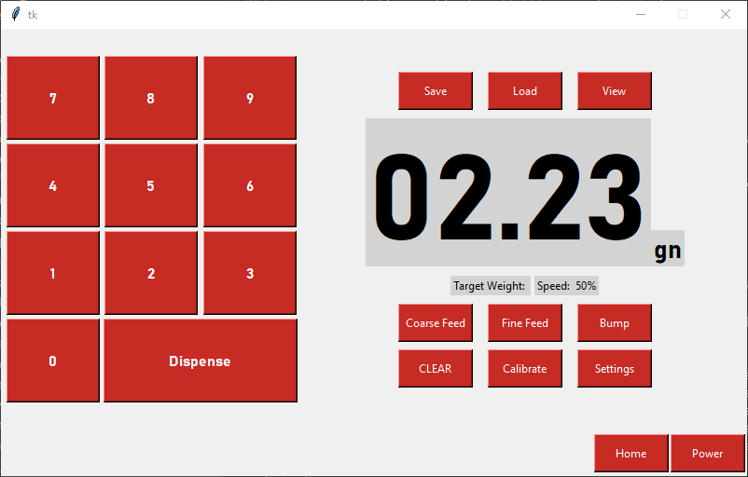
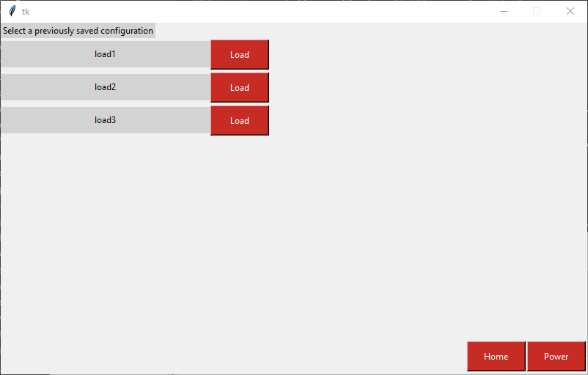
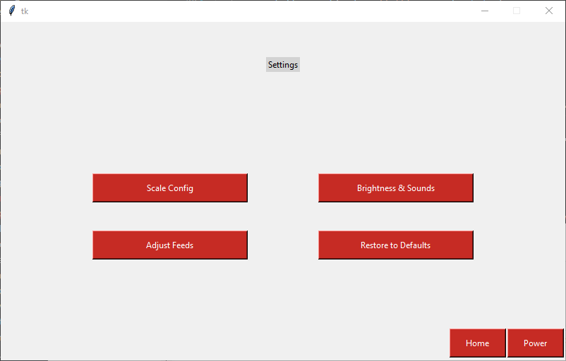
Progress made during the week (Log) (What I did)
Started Settings page
Started Save page
Load page is now working

Slide 17
Difficulties encountered during the week (What I did not do and why)
Learning the UI library as I go

Slide 18
Goals for this coming week (Ones that move the project forward the most)
Goal/Task | Stop Date (Est.) | Hours (Est.)
Finish Save screen |  | 4
Finish Settings screen and sub screens |  | 7
Collaborate with Jonathan to get images in the design |  | 2
Collaborate with Austin to ensure UI and back-end can communicate |  | 1
Estimated time needed to work on goals for this coming week | 14

Slide 19
Week 7 (16-Feb to 22-Feb) Jonathan Phillips
Goal/Task | % Done | Hours (Act.)
Front end – Implementation of images as buttons | 80 | 4
Front end Meeting | 100 | 1
Front end – General Progression | N/A | 5
Hours on task during the week (On track ≥ 10 / wk) | 10
Total hours on task so far this semester (On track ≥ 85 hrs) | 75

Slide 20
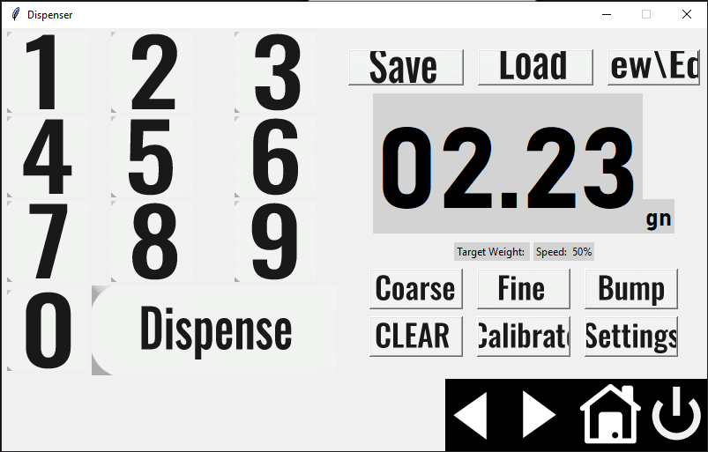
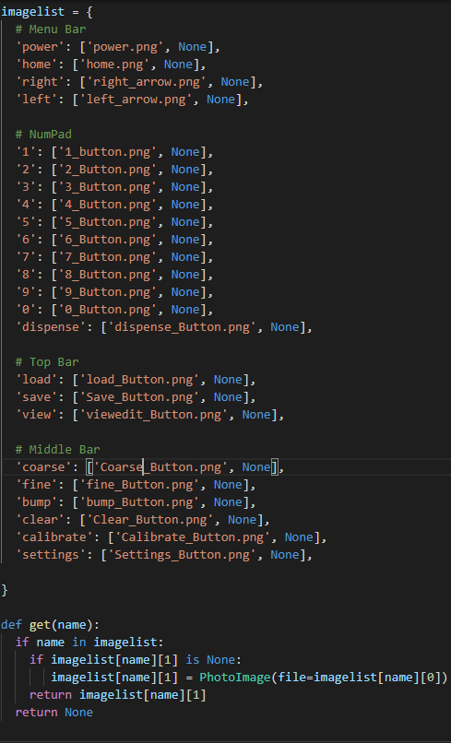
Progress made during the week (Log) (What I did)

Slide 21
Difficulties encountered during the week (What I did not do and why)
Exact Sizing of the Images on Screen

Slide 22
Goals for this coming week (Ones that move the project forward the most)
Goal/Task | Stop Date (Est.) | Hours (Est.)
Front End – Implementation of Images as Buttons | 3/1/22 | 3
Front End – Working on the other Pages
Front End – General Progression | 4/6/22
Estimated time needed to work on goals for this coming week (typ. 13 hrs) | 13

Slide 23
How can we help you achieve your goals?
Keep on Keeping on

